Slide 1

A Local-First AI Workspace for macOS
🖥️ Runs on Your Mac
🔗 Flexible Models
Your data never leaves your device
Connect to local or cloud language models
🔓 Fully Open Source
Anyone can read, audit, and verify the code

Slide 2



The Goal Is Accessible, Private, Local AI
Most AI products are cloud services — your conversations pass through servers you don't control. Professionals handling sensitive material have few good alternatives.
Works Offline
No internet connection required for local models
No Conversation Tracking
Your sessions stay on your machine, period
Understands Your Files
Indexes and retrieves from your own personal data
Open Source
Every line of code is readable and verifiable

Slide 3
Four Main Capabilities
Chat
Deep Research
Streaming conversations, branching history, and inline source references
Multi-step web research that produces a fully structured report
Creation
Actions
Canvas for docs, code & sites — plus Slide Studio, Diagrammer, and a Writing Assistant
Web search, file access, calendar, contacts, code execution, and reminders

Slide 4
The Model Is a Setting, Not the Product
Switch between local and cloud models without changing how you work. Same interface, same tools, same retrieval — every time.
🏠 Local
☁️ Cloud
Runs on Apple Silicon via llama.cpp
Works fully offline
Supports Llama, Qwen, Gemma, and more
Nothing ever leaves your device
Connects to any OpenAI-compatible API
Same interface, same tools, same retrieval
You provide your own API key
Full control over which provider you use

Slide 5
"Help me plan two weeks in Japan in the fall."
A single prompt triggers a full end-to-end workflow — from clarifying questions to a finished slide deck.
Clarify
1
Asks about your pace, travel style, and preferences
Research
2
Searches travel, weather, and logistics sources across the web
Retrieve
3
Finds a note you wrote months ago mentioning Kyoto
Draft
4
Writes a full day-by-day itinerary in Canvas
Present
5
Turns your itinerary into a slide deck via Slide Studio

Slide 6
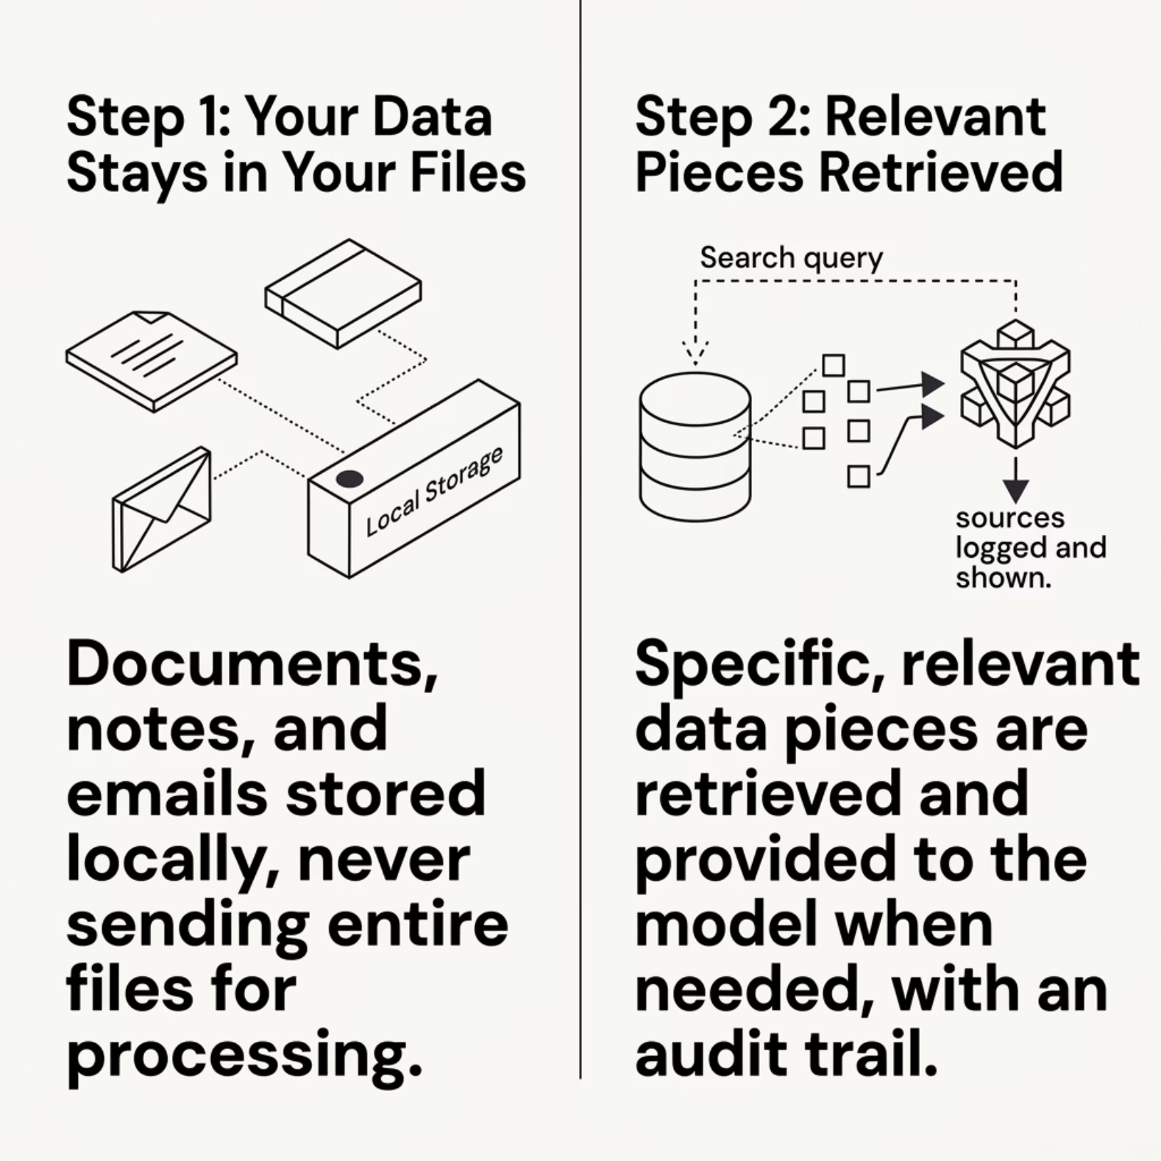

What "Retrieval-Augmented Generation" Actually Means
How It Works
A language model knows general knowledge, not your files
The app searches your data and retrieves the most relevant text
The model answers using that context, with sources logged and shown —> RAG

Slide 7
Experts and Brain
Two retrieval modes to ground the agent in your data:
Experts
Unified Brain
Scoped to specific files, folders, or websites
Focused, precise retrieval
Can be proactive or on-demand
Personal data indexed from: Messages, Email, Documents, Notes, and Calendar.
New data is updated live as it comes in
Experts = Focused
Brain = Broad
Scoped to the exact material you define
Searches across your full personal data landscape

Slide 8
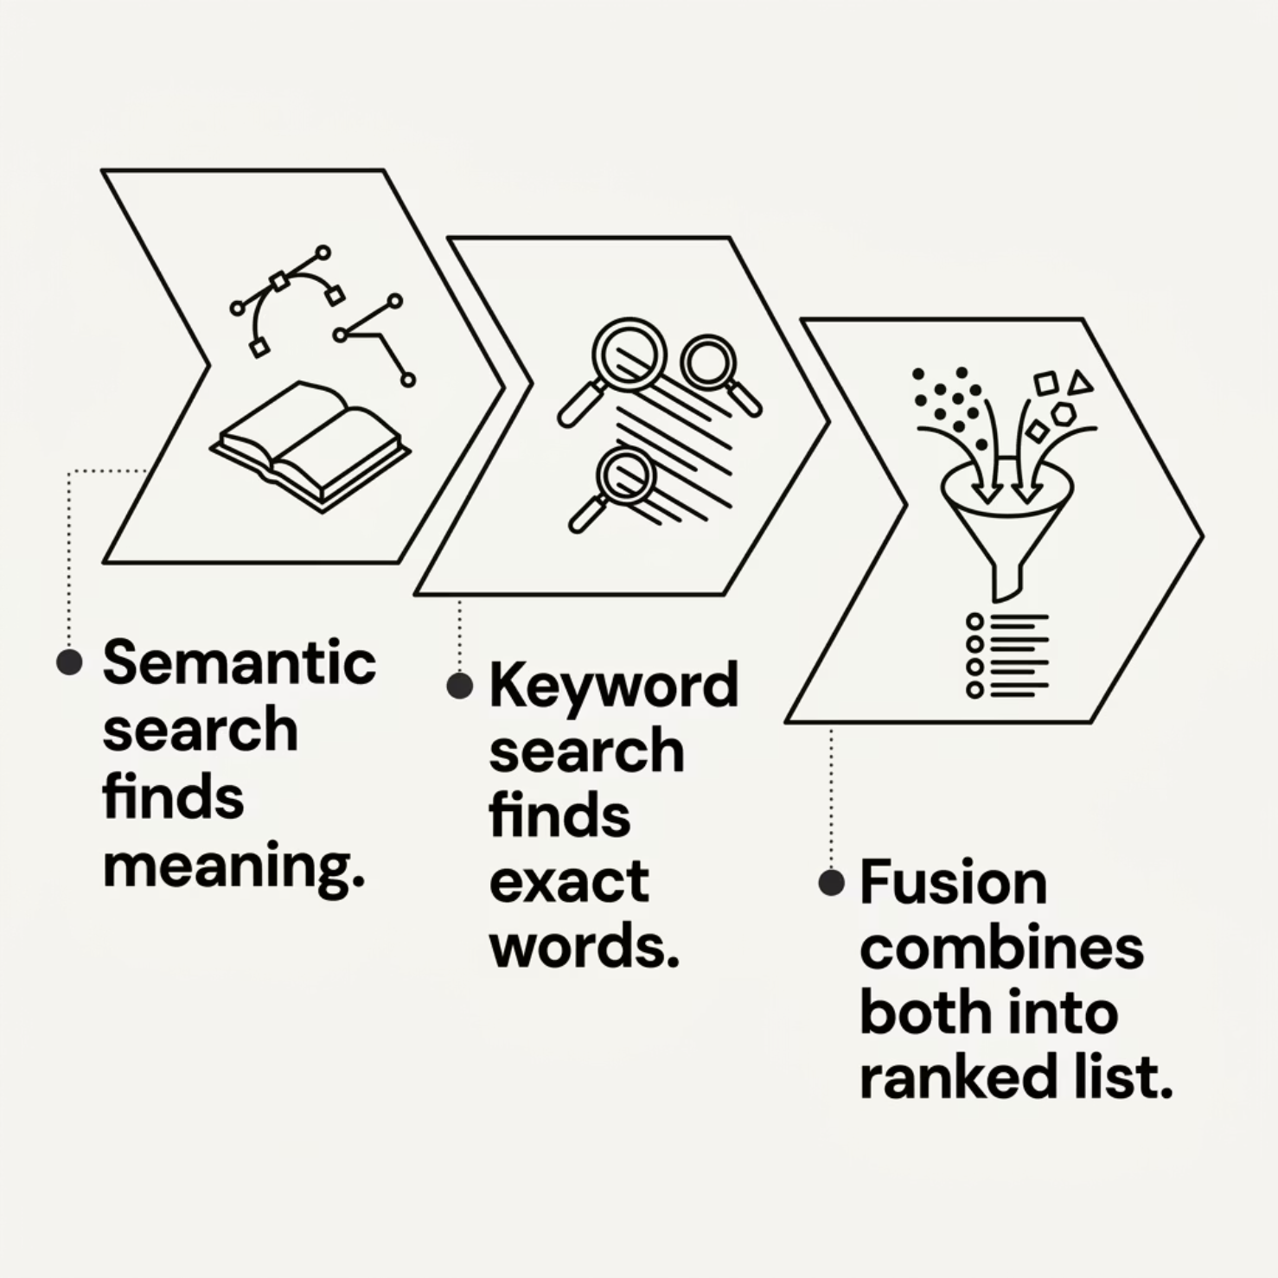

Hybrid Dense and Sparse Retrieval
How the Brain Searches
Dense search converts text into vectors and matches by meaning, even when words differ.
Sparse search matches exact or near-exact keywords, which works well for names, dates, and phrases.
Fusion step combines both signals into one ranked list, then expands the top results with surrounding context.

Slide 9
"What was the restaurant my sister recommended last year?"
The Brain turns a vague memory into a calendar event — in four steps.
1
Search
Brain searches the Messages collection
2
Find
Locates the conversation from 11 months ago, identifies your sister, returns her exact recommendation
3
Verify
You ask if it's still open — it searches the web to confirm
4
Act
"Add it to my calendar for Saturday" — event created

Slide 10

From Question to Answer: The Full Loop
Context Assembly
Memory & Retrieval
Iteration Limit
Tool Loop
Context Assembly
Tool Loop
Iteration Limit
Memory, retrieval results, and attachments are added before the model sees anything
Model calls a tool → app executes it → result returns to model. Repeats as needed.
The loop stops automatically, bounded by a hard cap — always predictable and safe

Slide 11
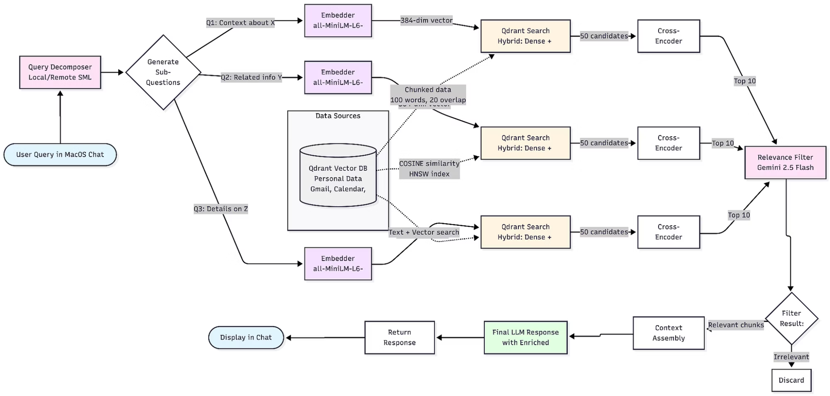
Architectural Overview
This zooms in to the specific working of the chat agent

Slide 13
Tools are loaded on demand, not all at once
A language model has a fixed context window. Loading every possible tool definition into every request wastes that valuable space and can significantly slow down the model's response time.
Our workspace maintains three essential tools always active: web search, Brain search for personal data, and a special tool to dynamically load additional capabilities. All other tools—such as calendar integrations, file access, code execution, contacts, and reminders—are initially represented by a compact index of their name and description. When the model determines it needs a specific tool, it calls a dedicated load_skills function to pull its full definition into context. Loaded skills are designed to expire automatically after a few turns of disuse, ensuring optimal context utilization.
Compact Index
Most tools exist as a minimal reference until their specific functionality is required by the model.
Dynamic Lifecycle
Full tool schemas load only when needed and are automatically unloaded to free up context space.

Slide 14


What leaves your machine and what does not
Understand the data flow with both local and cloud models, and how your privacy is protected.
Local Model: Absolute Privacy
Cloud Model: Opt-In Control
With local models, nothing leaves your machine. There are no servers, no logging, and no accounts involved, ensuring your data remains entirely on your device.
If you choose to use a cloud model, your query is sent to that provider under their terms. This feature is strictly opt-in, giving you full control.
Full Transparency: Agent Trace
macOS Permissions
All retrieval choices are meticulously logged in the Agent Trace. You can see exactly what the model searched and why, providing complete visibility into its actions.
Access to sensitive data via tools like Calendar or Contacts requires explicit macOS permission prompts, ensuring you always grant approval for data access.

